Slide 1

Mix Match and Beyond! – Effectiveness of SSL over the years
Abbaas Alif Mohamed Nishar
Department of Computer Science
April 16th,2024

Slide 2
Semi Supervised Learning
Dataset
Unlabeled Data
Labeled data

Slide 3
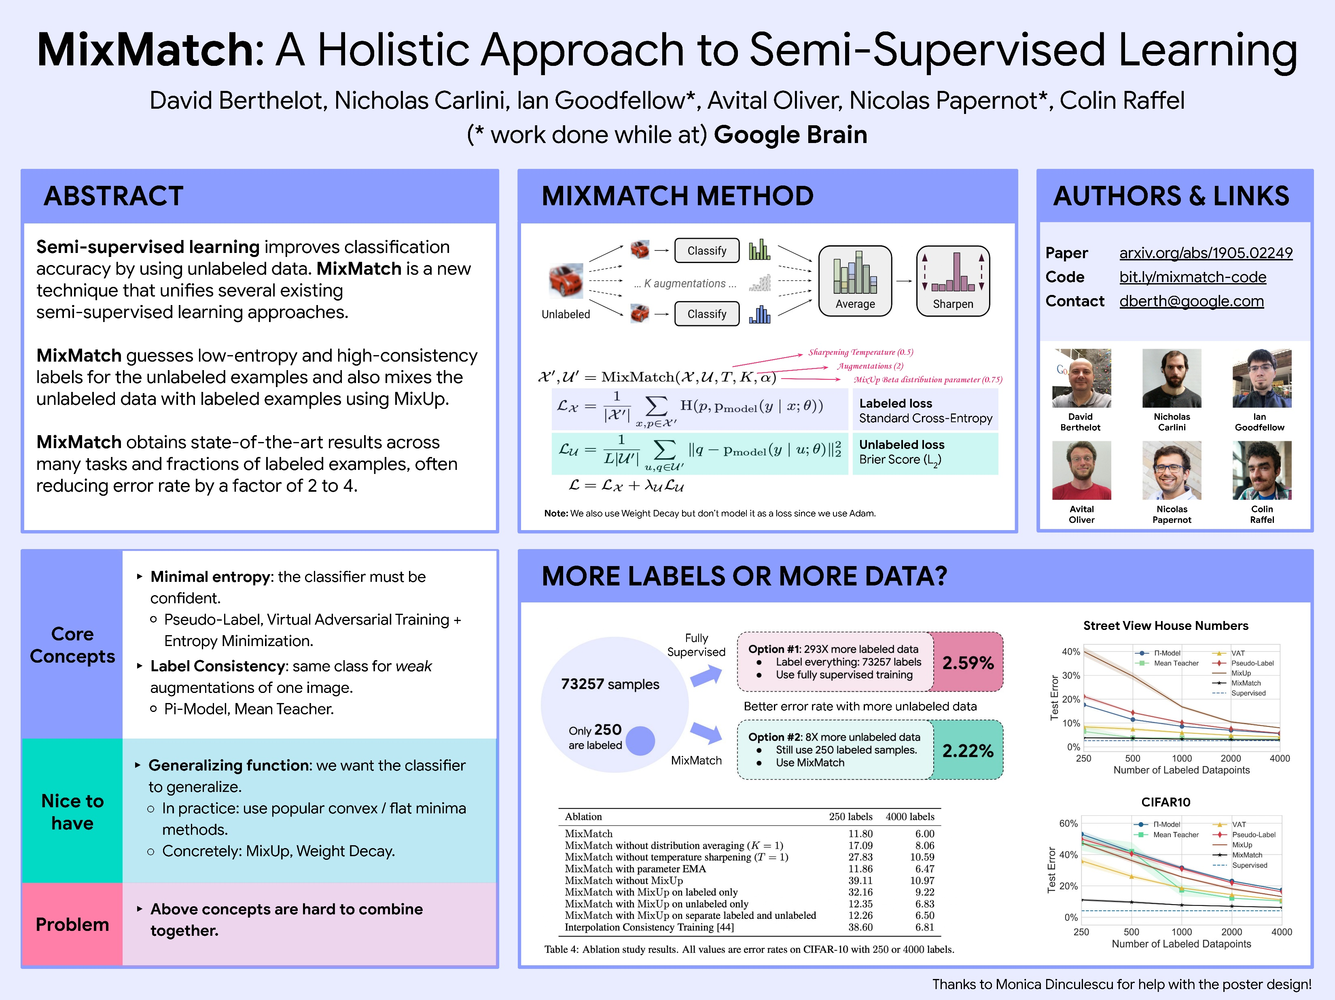
Notes:
Sharpening – take power 1/T and then apply softmax to get sharpened outputs.

Slide 4
Notes:
Sharpening – take power 1/T and then apply softmax to get sharpened outputs.

Slide 6
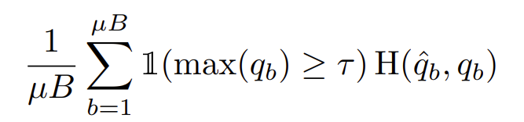
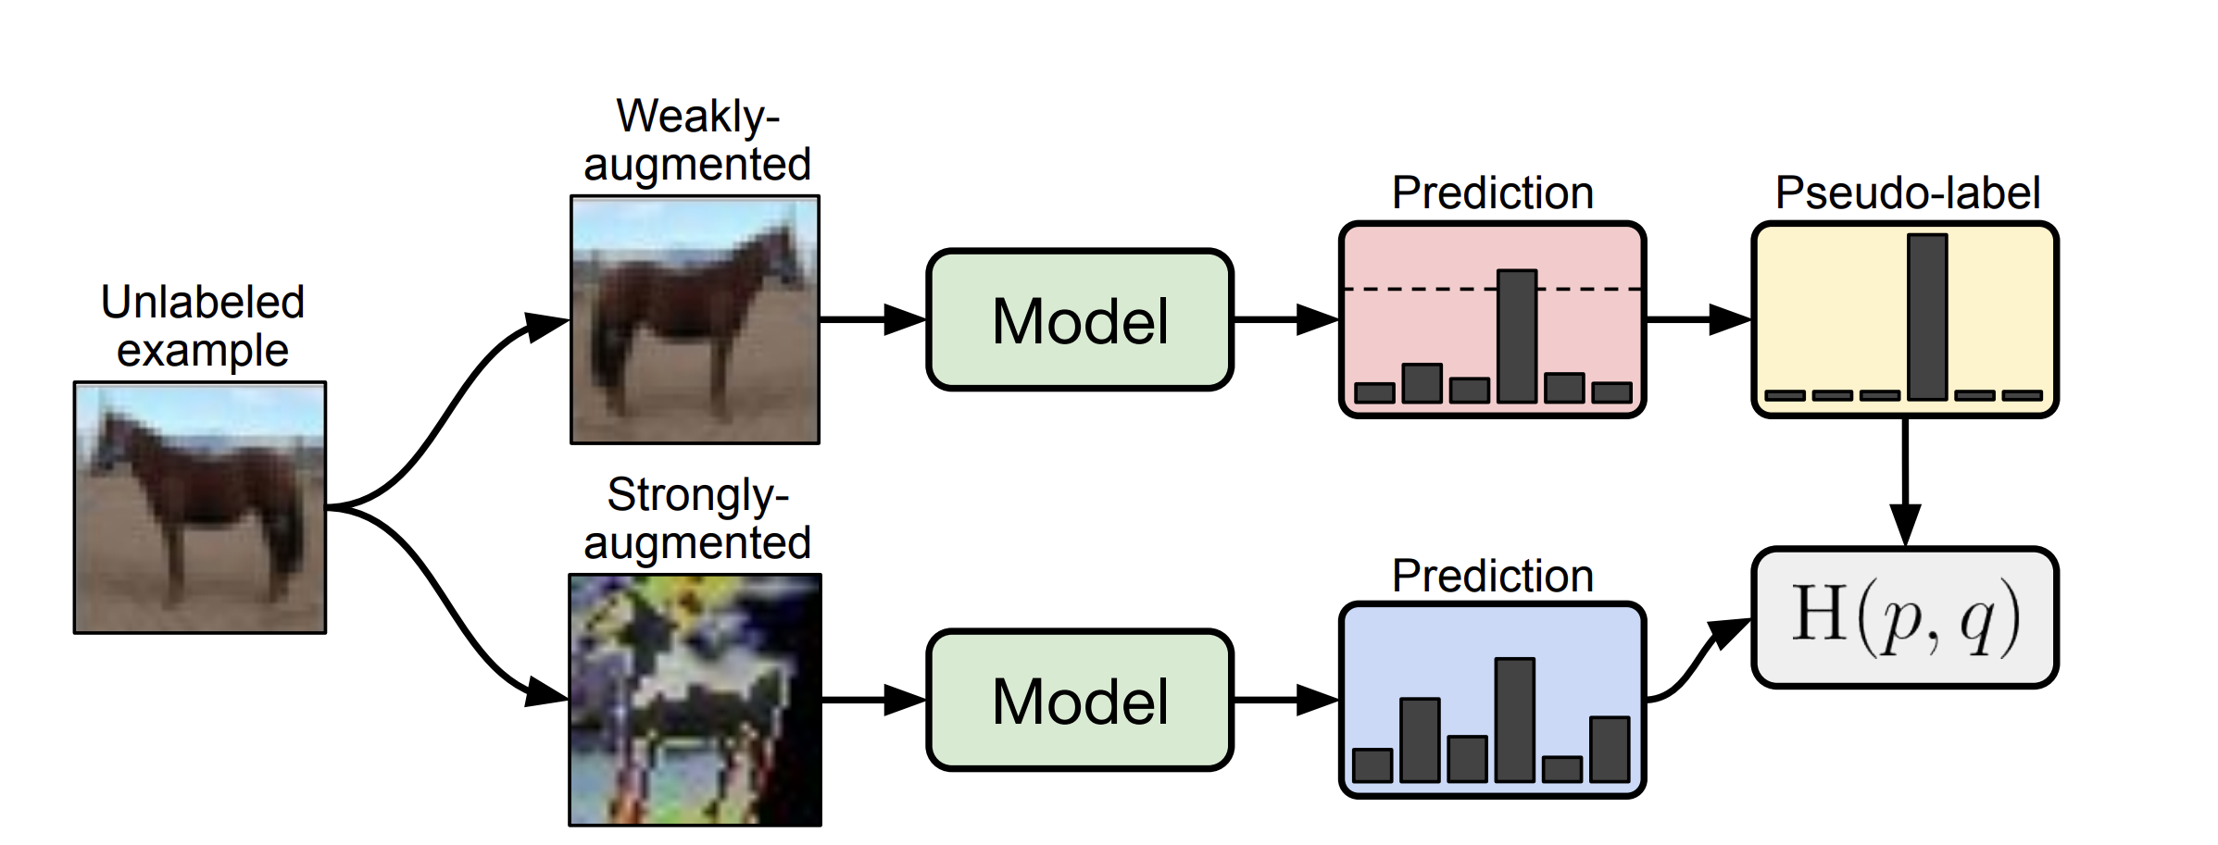
FixMatch

Slide 7
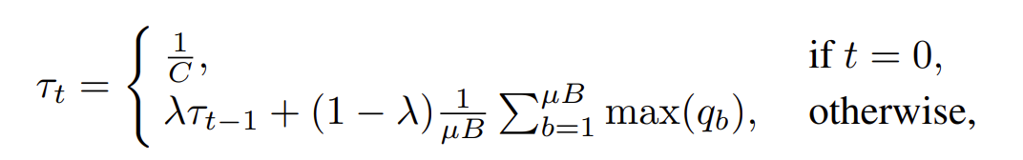
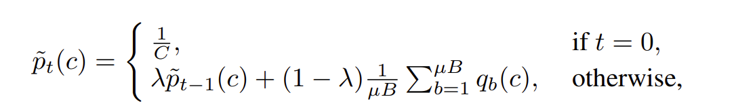

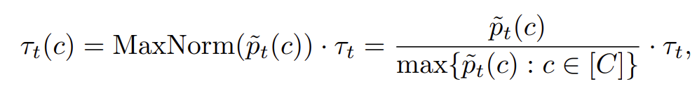
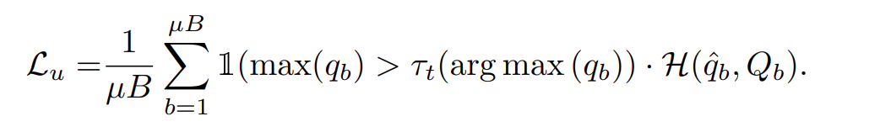
Self Adaptive Thresholding
Global Threshold
Local Threshold
Self Adaptive Threshold
Notes:
Where, number of unlabeled samples over the batch \mu is the parameter used to modulate the amount of unlabeled samples qb is the logits and max qb is the logit layer maximum output.

Slide 8
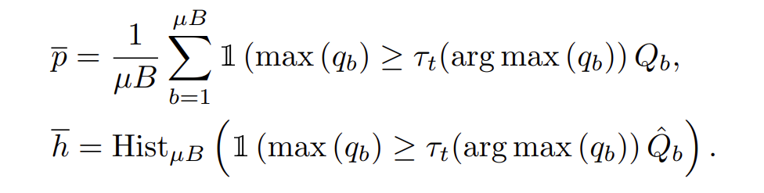

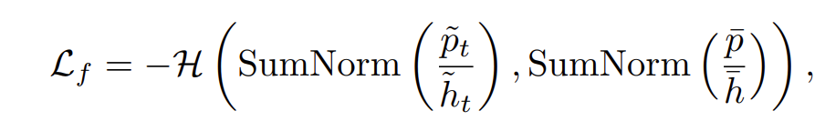
Self Adaptive Fairness

Slide 9

Complete Loss

Slide 10
Modifications for Improvement
Modification1:
Labeled loss: added label smoothing parameter
Consistency Loss: Enhanced Mask usage: used SoftMax weights
Consistency Loss: make the logits smoother (worst idea ever!!!) (I was not sure what I was thinking)
L2 regularization: Not bad! Prevents overfitting
SAF loss:
Self Entropy: calculate entropy of predicted probabilities for diversity
KL divergence: for additional regualization.
SAT loss:
Temperature to logits: added temperature for regularization.
Diversity Loss:
mean(sum(softmax(logits)*logsoftmax(logits))
Worst Idea ever!!! Completely performed bad from original
Modification 2:
Labeled loss: as original removed label smoothing
Consistency Loss:
L2 regularization: Not bad! Prevents overfitting
SAF loss:
Self Entropy: calculate entropy of predicted probabilities for diversity
KL divergence: for additional regualization.
SAT loss:
Diversity Loss:
mean(sum(softmax(logits)*logsoftmax(logits))
Performed better but still didn’t surpass original technique.
Modification 3:
Labeled loss: as original
Consistency Loss:
As original
SAF loss:
As original
SAT loss:
Added an attention layer for samples: A single attention layer that will look for important samples to focus on and boost their logits, hence altering global temperatures.
Performed better than Mod 1 and Outperformed Mod2 until a point and then saturated. Root cause the Attention layer did not let the global temperature go up causing sub optimal performance.

Slide 11
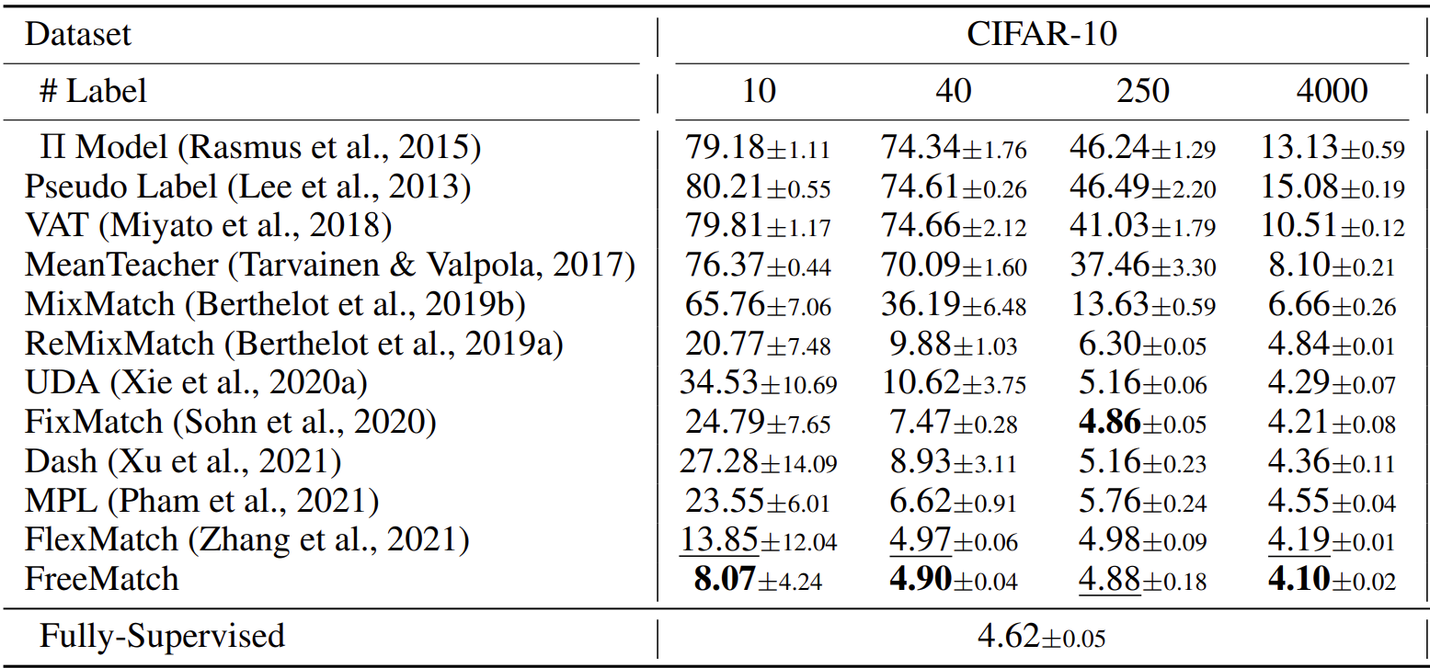
Results
Average Accuracy: 95.9

Slide 12
Tensorboard and Questions

